Slide 1
Programming Languages -1
(Introduction to C) pointers
Instructor: M.Fatih AMASYALI
E-mail:mfatih@ce.yildiz.edu.tr

Slide 2
Pointers
A variable in a program is stored in a certain number of bytes at a particular memory location, or address, in the machine.
Pointers allow us to manipulate these addresses explicitly.
Two unary operators:
  & operator – “address of”. Can be applied to any variable.
  * operator – “information at”. Can be applied only to pointers.
Pointer when declared points to an invalid location usually; so you must make it point to a valid one.

Slide 3
int a = 1, b = 2, *p;
char *char_p;
p = &a;
b = *p;
An assignment like char_p = &a; is illegal, as the types do not match.

Slide 4
Constructs not to be pointed at
Do not point at constants:
  int *ptr;
  *ptr = 3; /* OK */
  ptr = &3; /* illegal */
Do not point at arrays
  int a[77];
  int *ptr;
  ptr = a; /* OK */
  ptr = &a; /* illegal */
Do not point at expressions that are not variables.
  int k = 1, *ptr;
  *ptr = k + 99; /* OK */
  ptr = &(k + 99); /* illegal */

Slide 5
“Call by reference” (not really)
Pointers allow us to perform something similar to call-by-reference (we are passing pointers/references by value)
“call-by-reference” allows a function to make changes to a variable that persist
void set_int_to_3( int *p )
{
*p = 3;
}
void swap( int *p, int *q )
{
int temp;
temp = *p;
*p = *q;
*q = temp;
}

Slide 6
Example: Arrays as Function Arguments
(Array passed by reference, so changes to array persist)
int change_and_sum( int a[], int size )
{
int i, sum = 0;
a[0] = 100;
for( i = 0; i < size; i++ )
sum += a[i];
return sum;
}
int main()
{
int a[5] = {0, 1, 2, 3, 4};
printf( “sum of a: %d\n”,
change_and_sum( a, 5 ));
printf( “value of a[0]: %d\n”, a[0] );
}
Arrays are not passed with & because the array name is already a pointer

Slide 7
Pointer definitions
  Multiple pointers require using a * before each variable definition
      int *myPtr1, *myPtr2;
  Can define pointers to any data type

Slide 8
& (address operator)
  Returns address of operand
    int y = 5;
    int *yPtr;
    yPtr = &y; /* yPtr gets address of y */
    yPtr “points to” y

Slide 9
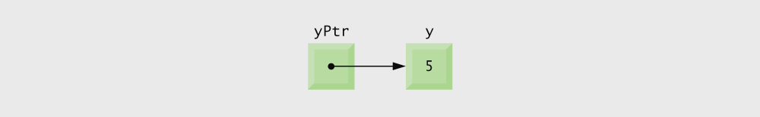
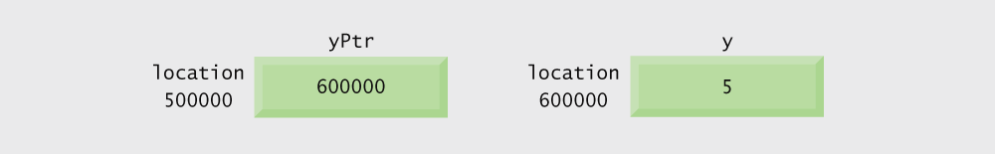
Graphical representation of a pointer pointing to an integer variable in memory.
Representation of y and yPtr in memory.

Slide 10
* (indirection/dereferencing operator)
  *yptr returns y (because yptr points to y)
  * can be used for assignment
    Returns alias to an object
      *yptr = 7; /* changes y to 7 */
* and & are inverses
  They cancel each other out

Slide 11
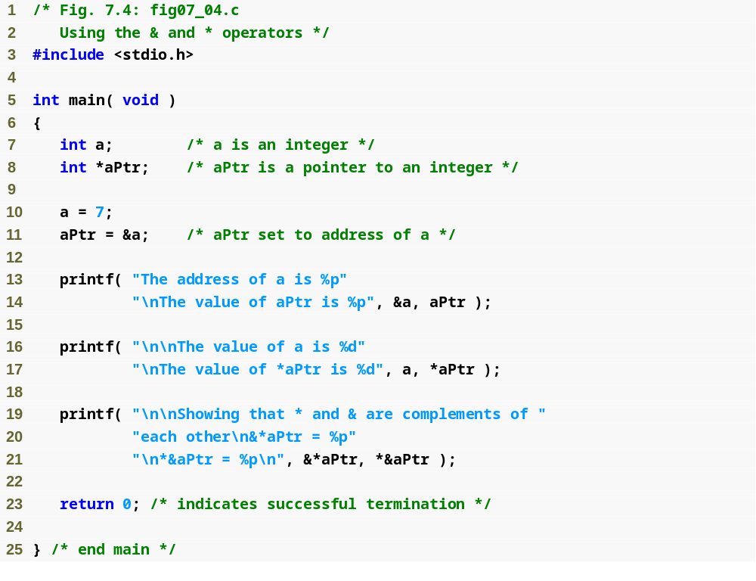
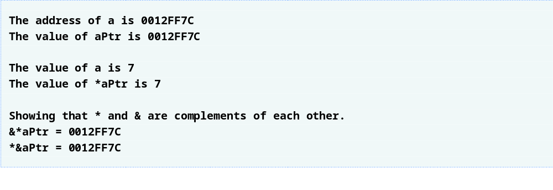
If aPtr points to a, then &a and aPtr have the same value.
a and *aPtr have the same value
&*aPtr and *&aPtr have the same value

Slide 12
örnek hafıza değişimleri
1) int a,*ptr,b,c,*d
2) a=25;
3) ptr=&a;
4) b=a;
5) c=*ptr
6) d=ptr;
adres | değişkenler | 1 | 2 | 3 | 4 | 5 | 6
1000 | a | Boş | 25 | 25 | 25 | 25 | 25
2000 | ptr | Boş | Boş | 1000 | 1000 | 1000 | 1000
3000 | b | Boş | Boş | Boş | 25 | 25 | 25
4000 | c | Boş | Boş | Boş | Boş | 25 | 25
5000 | d | Boş | Boş | Boş | Boş | Boş | 1000

Slide 13
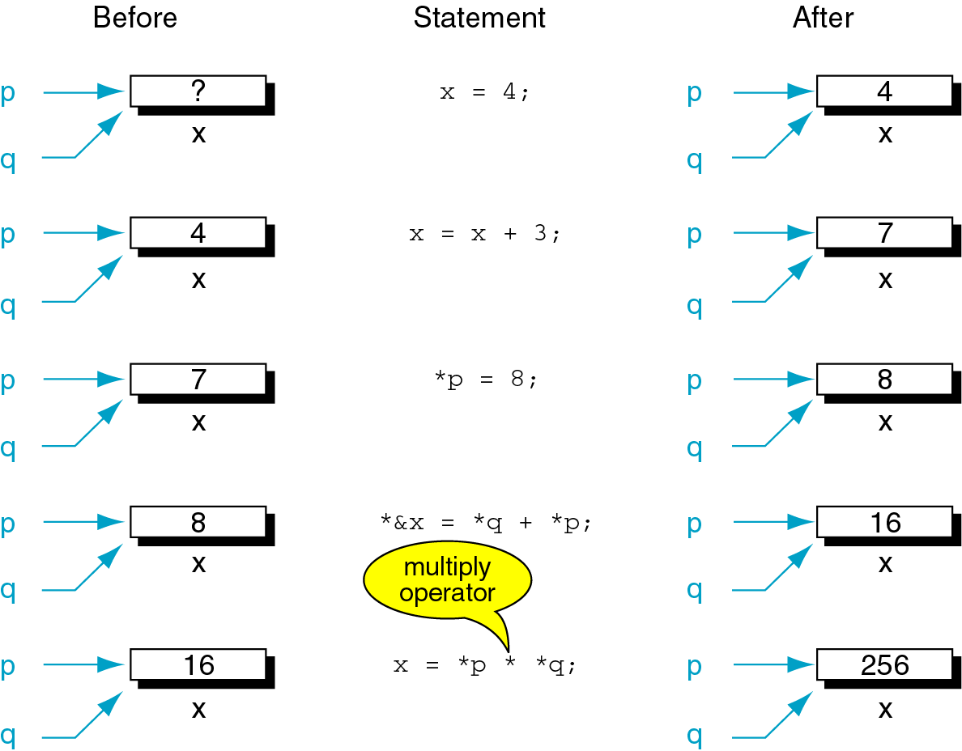
int x;
int *p=&x;
int *q=&x;

Slide 14
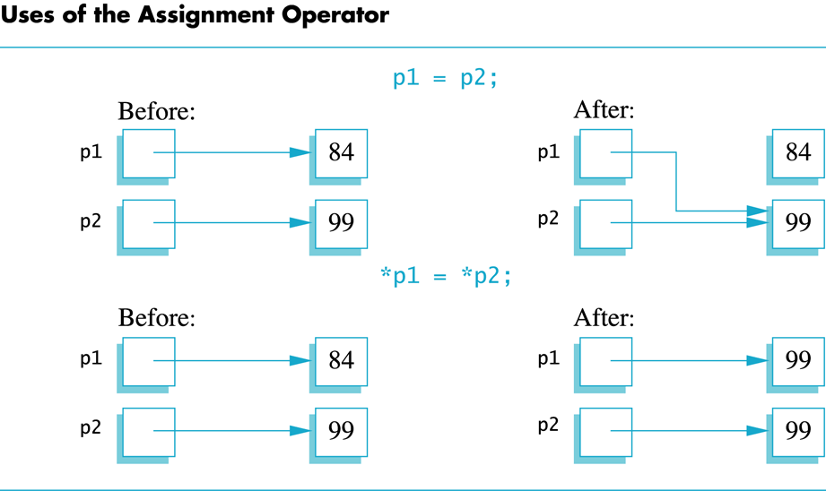
Caution! Pointer assignments

Slide 15
sizeof
  Returns size of operand in bytes
  For arrays: size of 1 element * number of elements
  if sizeof( int ) equals 4 bytes, then
      int myArray[ 10 ];
      printf( "%d", sizeof( myArray ) );
    will print 40
sizeof can be used with
  Variable names
  Type name
  Constant values

Slide 16
Portability Tip
The number of bytes used to store a particular data type may vary between systems. When writing programs that depend on data type sizes and that will run on several computer systems, use sizeof to determine the number of bytes used to store the data types.

Slide 17
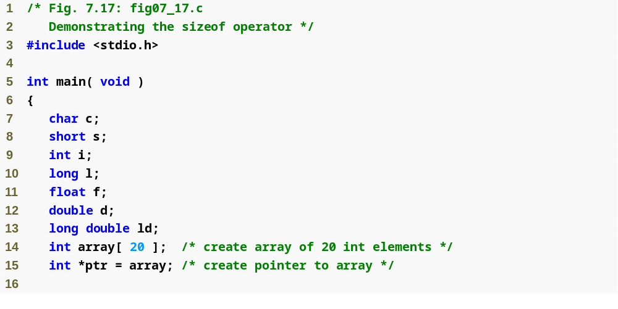

Slide 18
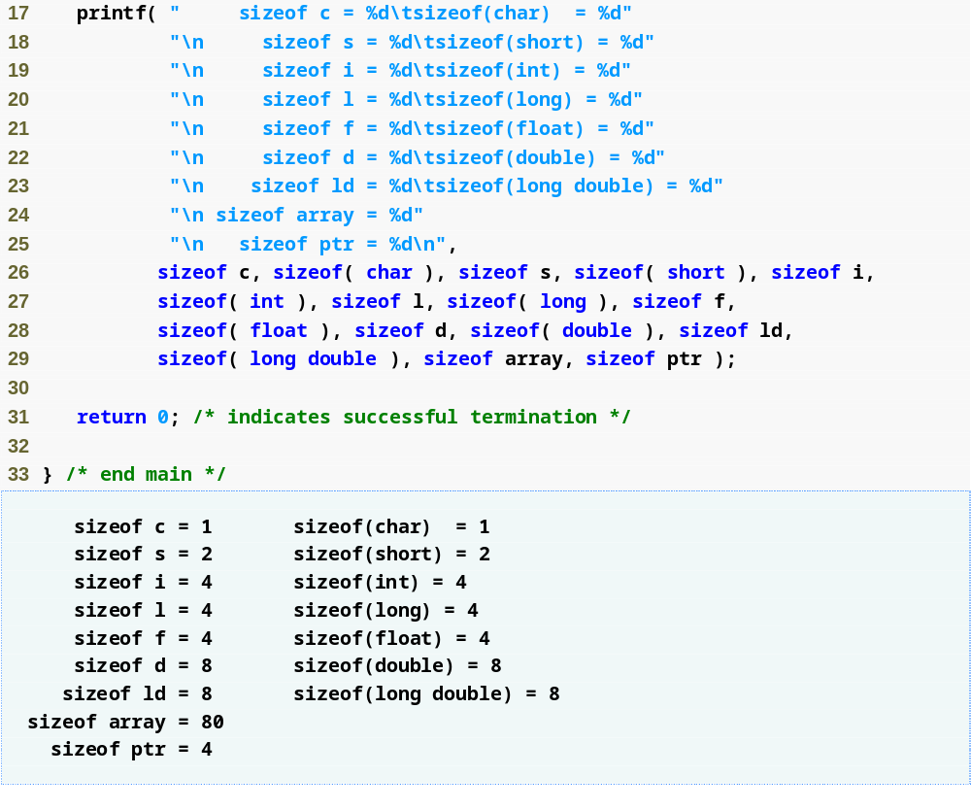

Slide 19
Pointer Expressions and Pointer Arithmetic
Arithmetic operations can be performed on pointers
  Increment/decrement pointer (++ or --)
  Add an integer to a pointer( + or += , - or -=)
  Pointers may be subtracted from each other

Slide 20
#include <stdio.h>
int main ()
{
double a=122.5,*c;
int b=10,*d;
c=&a; d=&b;
printf("a b c d degerleri %f %d %p %p \n",a,b,c,d);
c++; d--;
printf("a b c d degerleri %f %d %p %p \n",a,b,c,d);
}
a b c d degerleri 122.500000 10 0012FF84 0012FF7C
a b c d degerleri 122.500000 10 0012FF8C 0012FF78
// integer i gösteren pointer 4 azalmış, double gösteren pointer 8 artmıştır.
Pointer ları tamsayılarla toplamak pointer ın gösterdiği değişken türüne göre bir artım sağlar. 3 ile toplanırsa 3*(tututuğu tipin boyutu) kadar artar. Örneğin yukarıdaki programda c++ yerine c+=3 denseydi 8*3=24 artardı ve 0012FF9C olurdu.

Slide 21
Pointer Expressions and Pointer Arithmetic
5 element int array on machine with 4 byte ints
  vPtr points to first element v[ 0 ]
    at location 3000 (vPtr = 3000)
  vPtr += 2; sets vPtr to 3008
    vPtr points to v[ 2 ] (incremented by 2), but the machine has 4 byte ints, so it points to address 3008

Slide 22
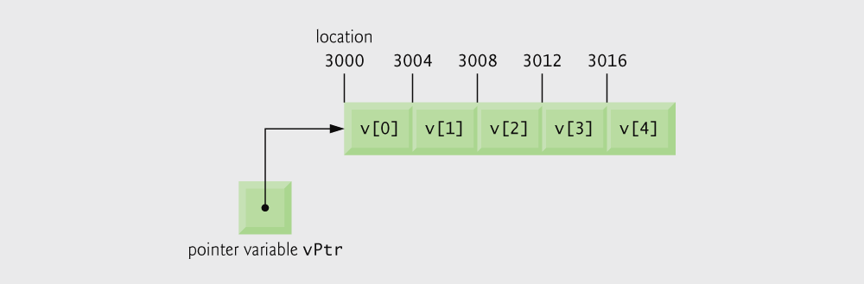
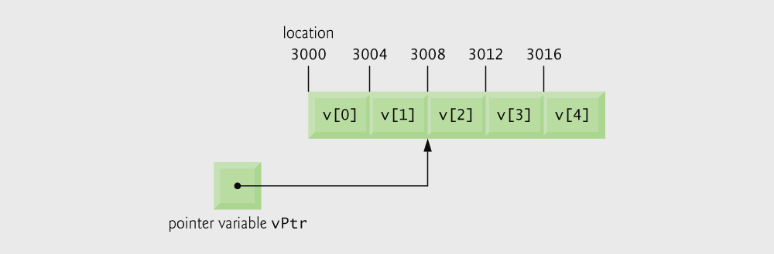
Array v and a pointer variable vPtr that points to v.
The pointer vPtr after pointer arithmetic.

Slide 23
Pointer Expressions and Pointer Arithmetic
Subtracting pointers
  Returns number of elements from one to the other. If
    vPtr2 = v[ 2 ];
    vPtr = v[ 0 ];
  vPtr2 - vPtr would produce 2
Pointer comparison ( <, == , > )
  See which pointer points to the higher numbered array element

Slide 24
Pointer Expressions and Pointer Arithmetic
Pointers of the same type can be assigned to each other
  If not the same type, a cast operator must be used

Slide 25
Arrays and Pointers (a difference)
An array is similar to a pointer
However:
  int i, a[10], *p;
  p=a; /* equiv. to p=&a[0]; */
  p++; /* valid */
  a++; /* error! */

Slide 26
Arrays and Pointers
Assume int i, a[10], *p;
  The type of a is “int *”.
  a is equivalent to &a[0]
  a + i is equivalent to &a[i]
Correspondingly,
  a[i] is equivalent to *(a + i)
In fact,
  p[i] is equivalent to *(p + i)
for( p = a; p < &a[10]; p++ )
sum += *p;
for( i = 0; i < 10; i++ )
sum += *(a + i);
p = a;
for( i = 0; i < 10; i++ )
sum += p[i];

Slide 27
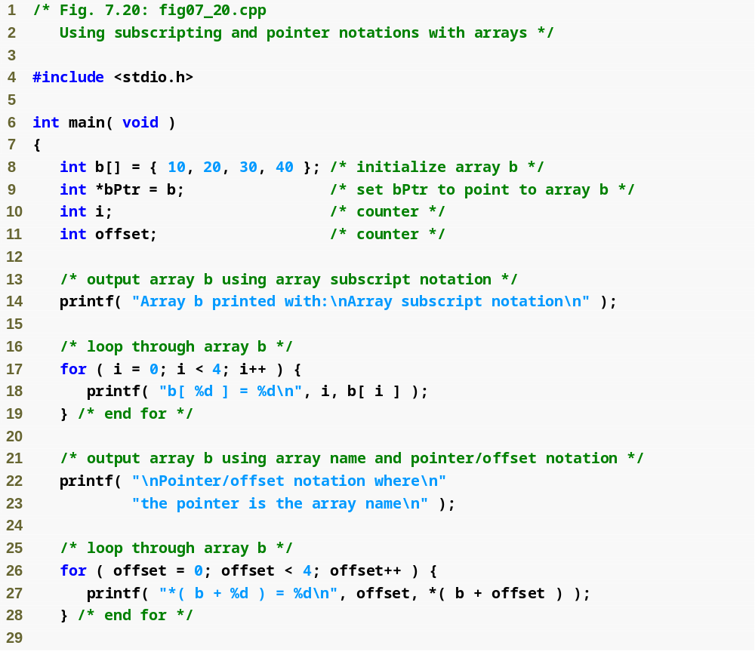
Array subscript notation
Pointer/offset notation

Slide 28
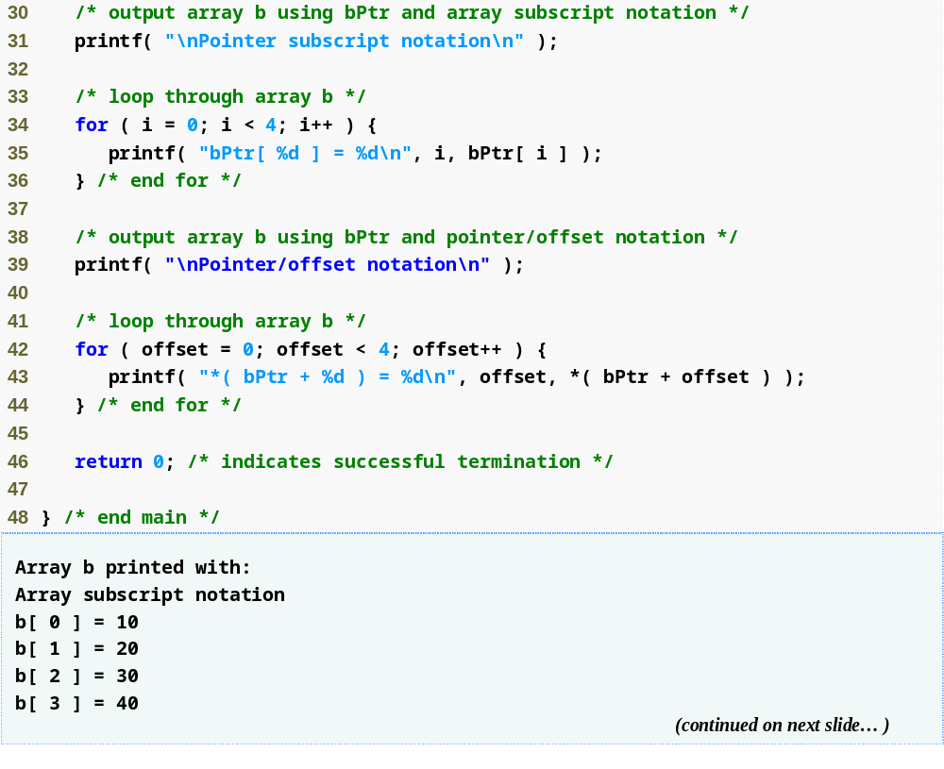
Pointer subscript notation
Pointer offset notation

Slide 29
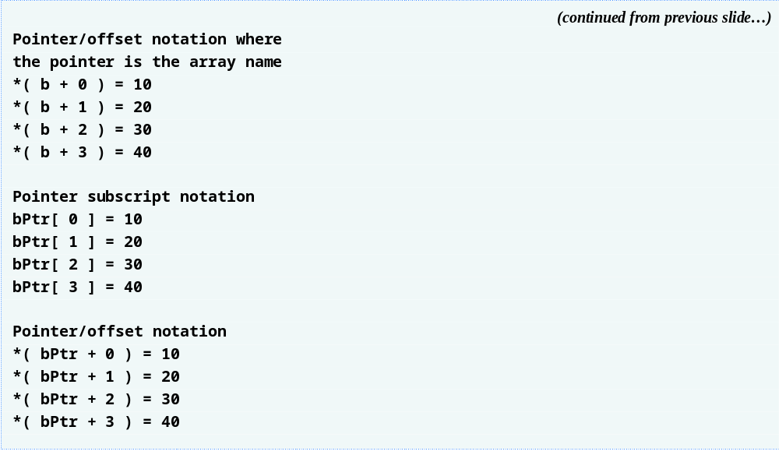

Slide 30
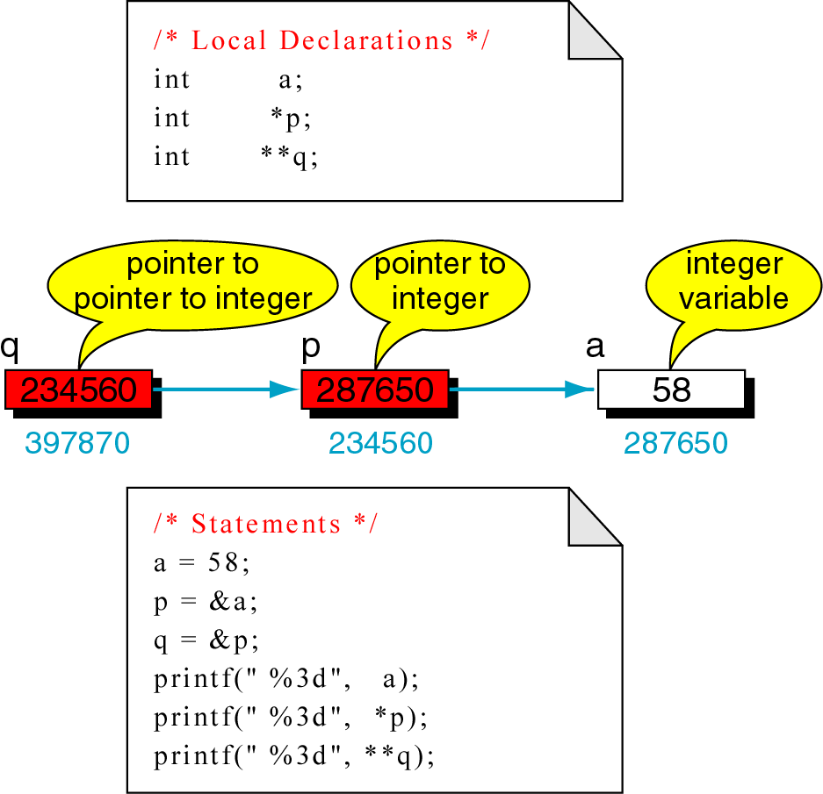
Pointers to Pointers
Output: 58
Output: 58
Output: 58

Slide 31
SORU: Aşağıdaki programın çıkışını yazınız.
int main(int argc, char* argv[])
{
int k[5]={50,80,60,14,32};
int *p,**pp;
p=k;
pp=&p;
printf("%d \n",*p);
p++;
printf("%d \n",*p);
printf("%d \n",**pp);
*p=43;
printf("%d \n",k[1]);
p+=2;
**pp+=32;
printf("%d \n",k[3]);
printf("%d \n",k[4]);
*pp-=1;
*p+=10;
printf("%d \n",*p);
printf("%d \n",**pp);
printf("%d \n",k[1]);
printf("%d \n",k[2]);
}
CEVAP:
50
80
80
43
46
32
70
70
43
70
p=k → k nın başlangıç adresini p ye atar.
pp=&p; → p nin adresini pp ye atar
p++ → p nin değerini arttırır
*p=3 → p nin gösterdiği adresin içeriğini 3 yapar
*pp-=5 → pp nin gösterdiği adresin içeriğini 5 azaltır
**pp-=2 → pp nin gösterdiği adresin gösterdiği
adresin içeriğini 2 azaltır.

Slide 32
Arrays of Pointers
Arrays can contain pointers
For example: an array of strings
    char *suit[ 4 ] = { "Hearts", "Diamonds",
    "Clubs", "Spades" };
  Strings are pointers to the first character
  char * – each element of suit is a pointer to a char
  The strings are not actually stored in the array suit, only pointers to the strings are stored

Slide 33
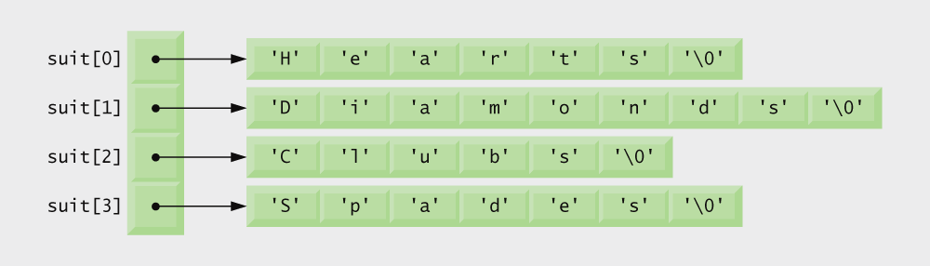
Graphical representation of the suit array.

Slide 34
Case Study: Card Shuffling and Dealing Simulation
Card shuffling program
  Use array of pointers to strings
  Use double subscripted array (suit, face)
  The numbers 1-52 go into the array
    Representing the order in which the cards are dealt

Slide 35
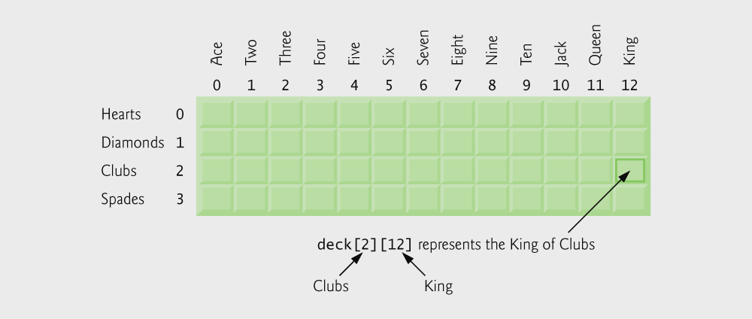
Kalp=heart
Karo=diamond
Sinek=club
Maça=spade
Double-subscripted array representation of a deck of cards.

Slide 36
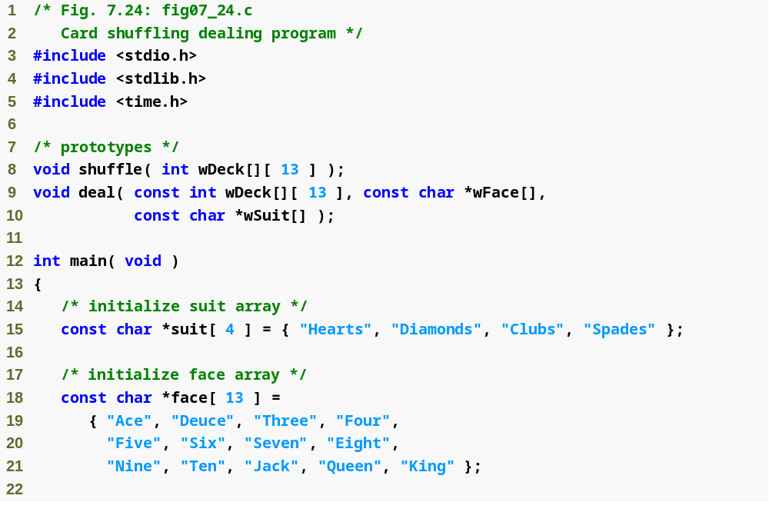
suit and face arrays are arrays of pointers

Slide 37
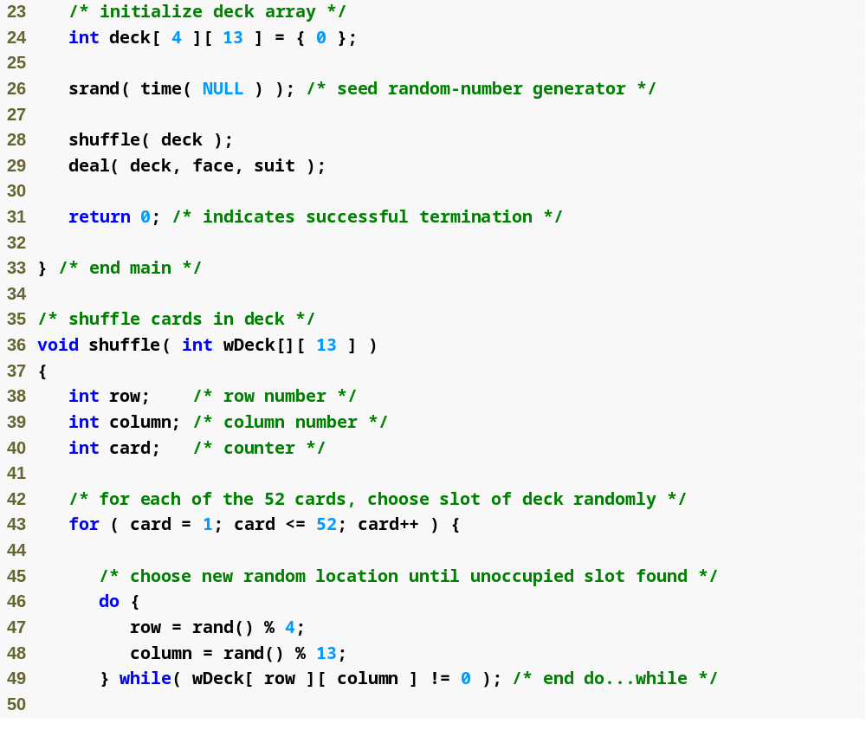
do…while loop selects a random spot for each card

Slide 38
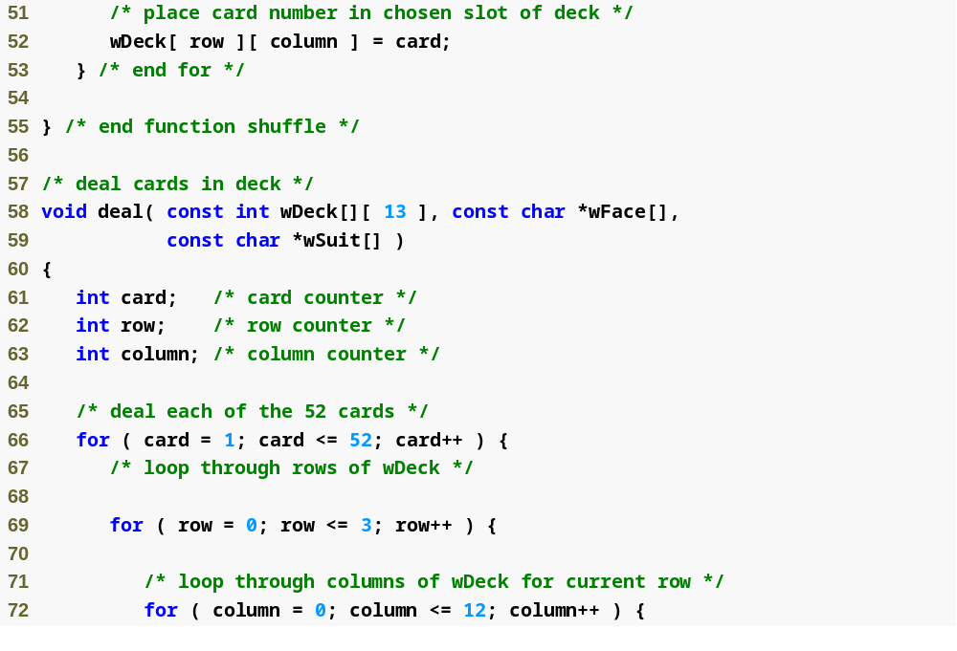
wDeck=two dim array
wFace=one dim
wSuit=one dim
wDeck requires number of columns

Slide 39
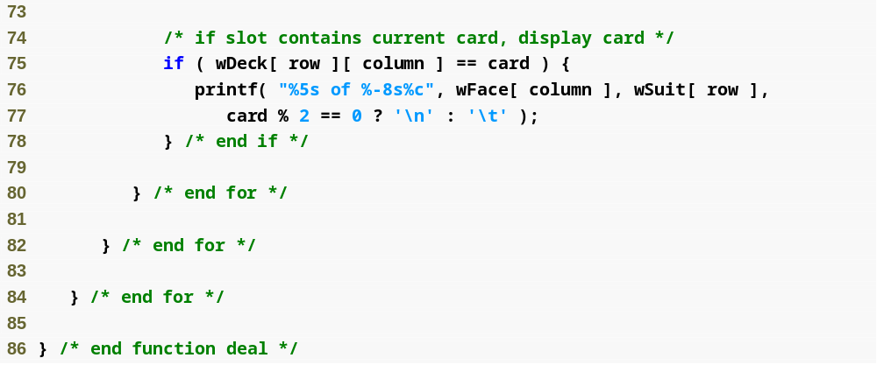

Slide 40
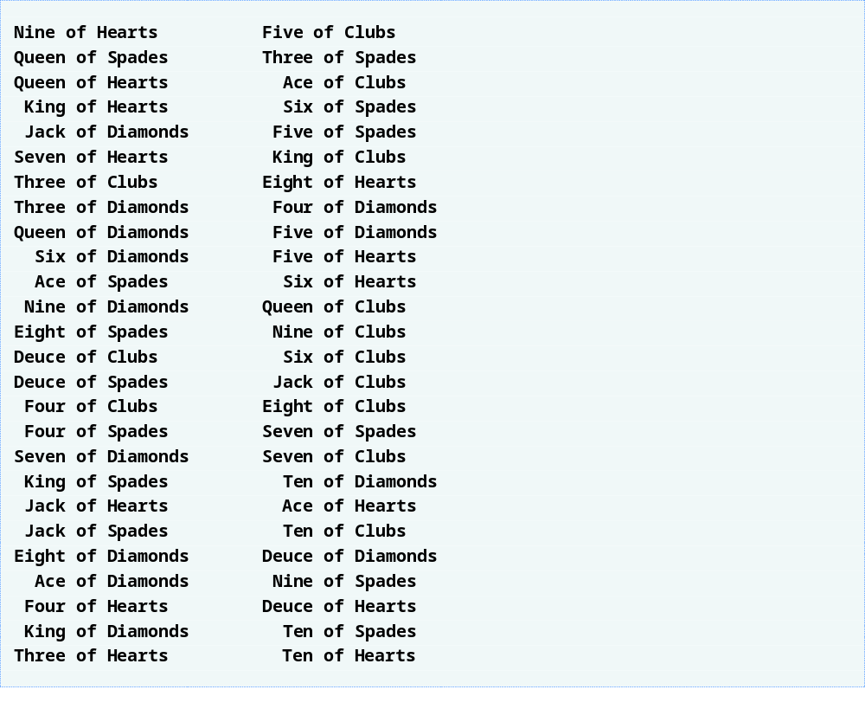

Slide 41
Pointers to Multidimensional arrays
matrix[0][0] = *(*(matrix))
matrix[i][j] = *((*(matrix)) + (i * COLS + j))
matrix[i][j] = *(*(matrix + i) + j)
matrix[i][j] = *(matrix[i] + j)
matrix[i][j] = (*(matrix + i))[j]
matrix = pointer to a pointer
*matrix = & matrix[0][0]
matrix+x adds (x*COLS*sizeon(int))
*matrix+x adds (x*sizeof(int))

Slide 42
#include <stdio.h>
#include <conio.h>
#define D1 2
#define D2 3
#define D3 4
/* function prototypes */
void printArray( int dizi[][D2][D3], int d1, int d2, int d3 );
void printArray( int dizi[][D2], int d1, int d2 );
void printArray( int dizi[], int d3 );
/* function main begins program execution */
int main( void )
{
int d1,d2,d3;
d1=D1;
d2=D2;
d3=D3;
int array1D[D3] ={3,4,5,6};
int array2D[D1][D2] ={{3,4,5},
{6,7,8}};
int array3D[ D1 ][ D2 ] [ D3 ] =
{ { {1,2,3,4}, {5,6,7,8}, {9,10,11,12}},
{ {13,14,15,16}, {17,18,19,20}, {21,22,23,24} }};
printf( "The arrays are:\n" );
printArray (array1D,d3);
printArray (array2D,d1,d2);
printArray( array3D,d1,d2,d3 );
getch();
return 0;
}

Slide 43
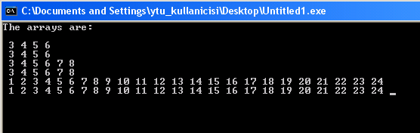
void printArray( int dizi[][D2][D3], int a1, int a2, int a3 )
{
int i,j,k; /* counters */
printf( "\n ");
for ( i = 0; i < a1; i++ ) {
for ( j = 0; j < a2; j++ ) {
for ( k = 0; k < a3; k++ ) {
printf( "%d ", dizi[i][j][k] );
}
}
}
printf( "\n ");
for ( i = 0; i < (a1*a2*a3); i++ )
printf( "%d ", *(*((*dizi)) + i) );
}
void printArray( int dizi[], int a3 )
{
int i; /* counter1 */
printf( "\n ");
for ( i = 0; i < a3; i++ )
printf( "%d ", dizi[i] );
printf( "\n ");
for ( i = 0; i < a3; i++ )
printf( "%d ", *(dizi+i) );
}
void printArray( int dizi[][D2], int a1, int a2 )
{
int i; /* counter1 */
int j; /* counter2 */
printf( "\n ");
for ( i = 0; i < a1; i++ ) {
for ( j = 0; j < a2; j++ ) {
printf( "%d ", dizi[i][j] );
}
}
printf( "\n ");
for ( i = 0; i < (a1*a2); i++ )
printf( "%d ",*((*dizi) + i) );
}

Slide 44
Pointers to Functions
Pointer to function
  Contains address of function
  Similar to how array name is address of first element
  Function name is starting address of code that defines function
Function pointers can be
  Passed to functions
  Stored in arrays
  Assigned to other function pointers

Slide 45
Pointers to Functions
Example: bubblesort
  Function bubble takes a function pointer
    bubble calls this helper function
    this determines ascending or descending sorting
  The argument in bubblesort for the function pointer:
      int ( *compare )( int a, int b )
    tells bubblesort to expect a pointer to a function that takes two ints and returns an int
  If the parentheses were left out:
      int *compare( int a, int b )
    Defines a function that receives two integers and returns a pointer to a int

Slide 46
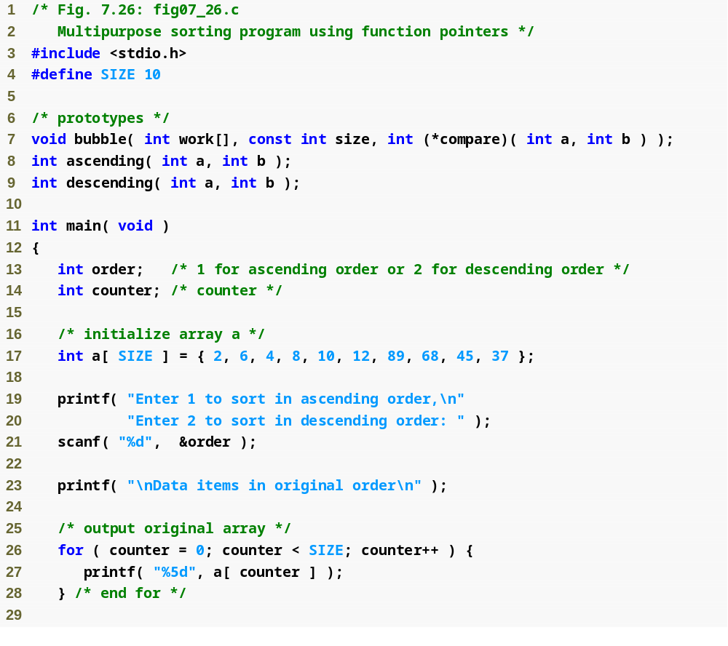
bubble function takes a function pointer as an argument

Slide 47
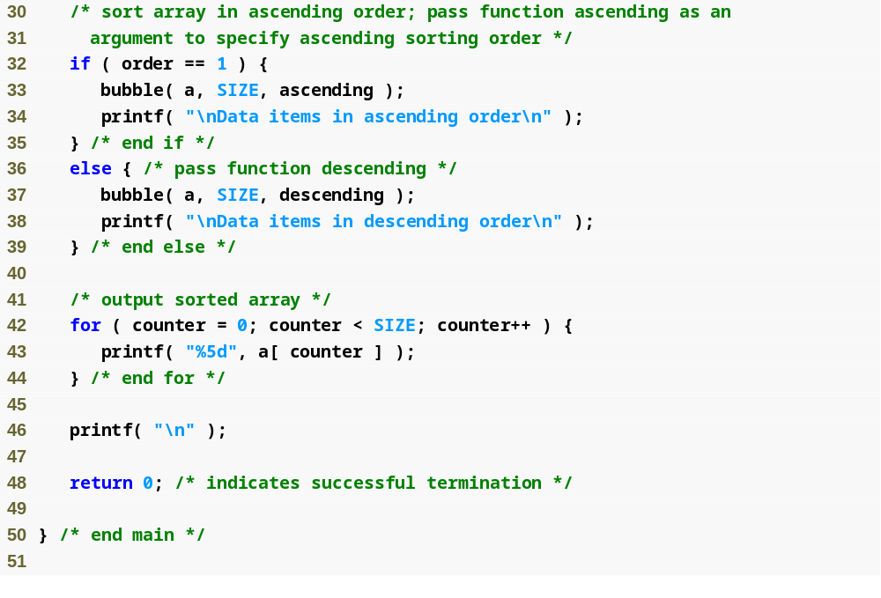
depending on the user’s choice, the bubble function uses either the ascending or descending function to sort the array

Slide 48
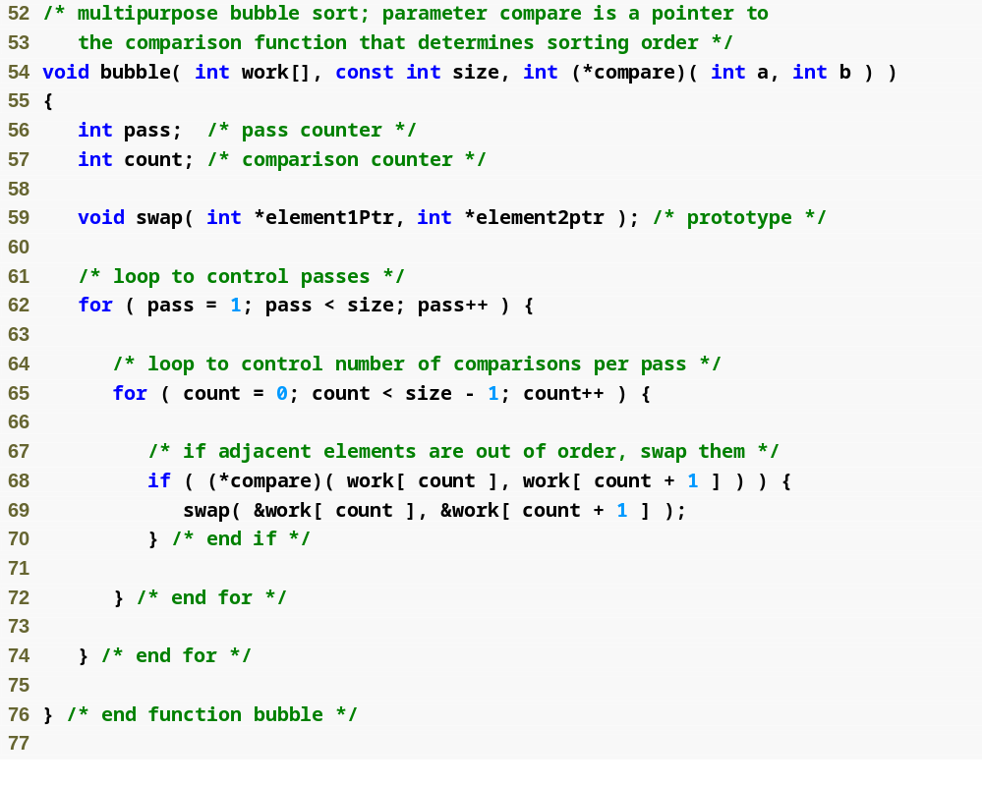
Note that what the program considers “out of order” is dependent on the function pointer that was passed to the bubble function

Slide 49
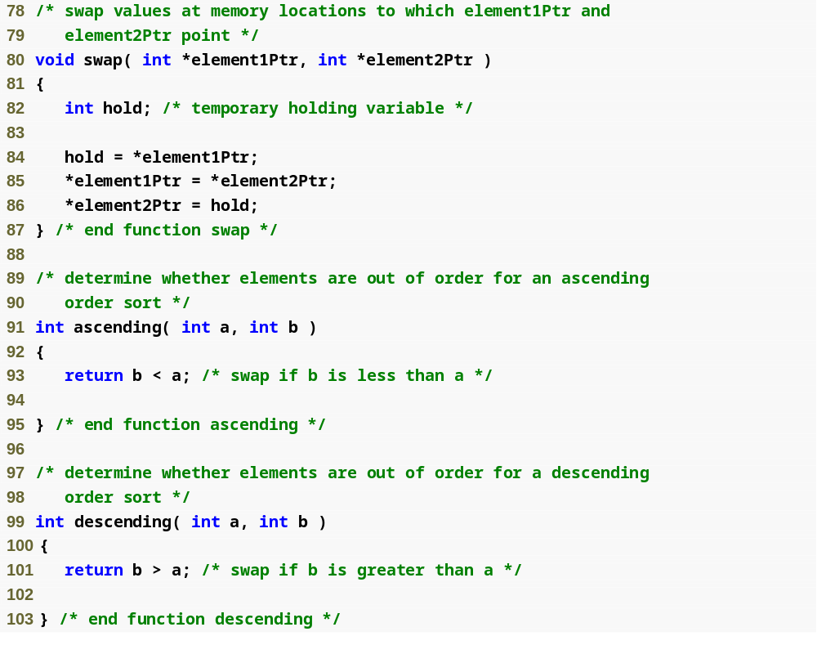
Passing the bubble function ascending will point the program here
Passing the bubble function descending will point the program here

Slide 50
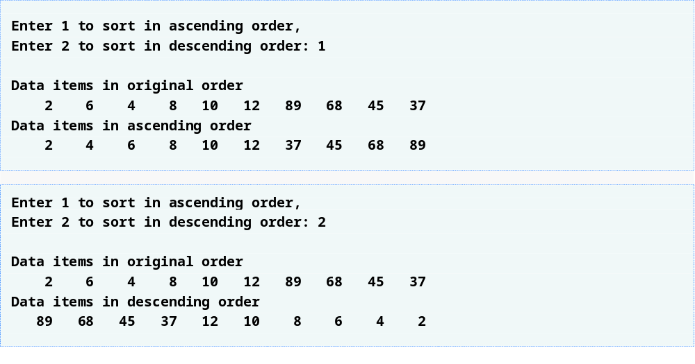

Slide 51
Command-Line Arguments
argc and argv
  In environments those support C, there is a way to pass command-line arguments or parameters to a program when it begin executing.
  When main is called to begin execution, it is called with two arguments – argc and argv
    argc : The first (conventionally called argc) is the number of command-line arguments the program was invoked with
    argv : The second (conventionally called argv) is a pointer to an array of character strings that contain the arguments, one per string.
  Example:
  if echo is a program and executed on unix prompt, such as
    10 <user:/home/droberts> echo hello world
argv
pointer array
e c h o \0
argc
h e l l o \0
3
null
w o r l d \0

Slide 52
Command-Line Arguments
Example: print out the arguments. ex: hello world
    main (int argc, char *argv[])
    {
    int i;
    for (i = 1; i < argc; i++)
    printf(“%s%c”, argv[i], (i < argc-1) ? ‘ ’ : ‘\n’);
    }
    main (int argc, char *argv[])
    {
    while (--argc > 0)
    printf(“%s%c”, *++argv, (argc > 1) ? ‘ ’ : ‘\n’);
    }
What if
“*++argv” ⬅ “*argv++”

Slide 53
Referance
Ioannis A. Vetsikas, Lecture notes
Dale Roberts, Lecture notes

